Slide 1
Contract Monthly Claim System
Lecturer Claim Management - A comprehensive web application for automated claim processing and approval workflows.
By ST10440287
PROG6212 – 21 November 2025

Slide 2
Contents
01. Problem & Solution
Understanding manual claim processing challenges and introducing automated solutions for efficiency.
02. System Overview
Comprehensive web application features, architecture, and multi-role access control system.
03. Technical Implementation
Automated verification, approval workflows, database design, and security measures implementation.
04. Results & Future
Testing validation, benefits analysis, future enhancements, and comprehensive system demonstration.

Slide 3
Introduction & Problem Statement
Current Challenges
Paper-based submissions lead to lost documents
No real-time tracking of claim status
Manual verification causes significant delays
Difficult to generate comprehensive reports
Automated Solution
Web-based comprehensive claim management system
Real-time tracking and status updates
Automated verification with risk scoring
Multi-level approval workflow automation

Slide 4
System Overview - CMCS
What is CMCS?
Contract Monthly Claim System is a comprehensive web application built with ASP.NET Core MVC for managing lecturer monthly claims with multi-role access and automated workflows.
Core Purpose
Simplify claim submission process, automate verification and approval workflows, provide real-time tracking capabilities, and generate comprehensive reports.
Multi-Role Access
Supports four distinct user roles with personalized dashboards and specific access levels for secure and efficient operations.

Slide 5
Key Features Overview
Automated Claim Submission
Calculate totals automatically with built-in validation and document management capabilities for streamlined processing.
Multi-Level Approval Workflow
Coordinator to Manager approval process with automated verification, risk scoring, and comprehensive policy checks.
Comprehensive Reporting Suite
Generate CSV exports, payment invoices, and detailed analytics with secure document storage and retrieval system.
Real-Time Tracking System
Monitor claim status instantly with role-based access control and comprehensive HR management module integration.

Slide 6
User Roles & Access Control
The CMCS system implements a comprehensive role-based access control system with four distinct user types, each having specific responsibilities and access levels to ensure secure and efficient claim management operations.
Role | Responsibilities | Access Level | Key Functions
Lecturer | Submit claims, upload documents | View own claims only | Track status, resubmit
Programme Coordinator | First-level approval, verification | View pending claims | Review, approve, return
Academic Manager | Final approval, payment authorization | View all claims | Final decision making
HR Personnel | Manage lecturers, generate reports | System administration | User management, reporting

Slide 7
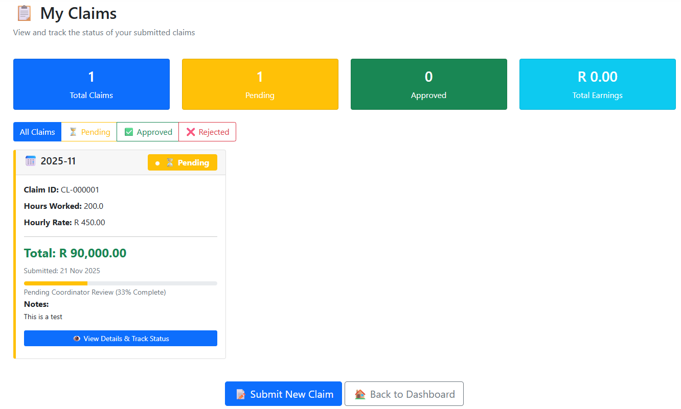
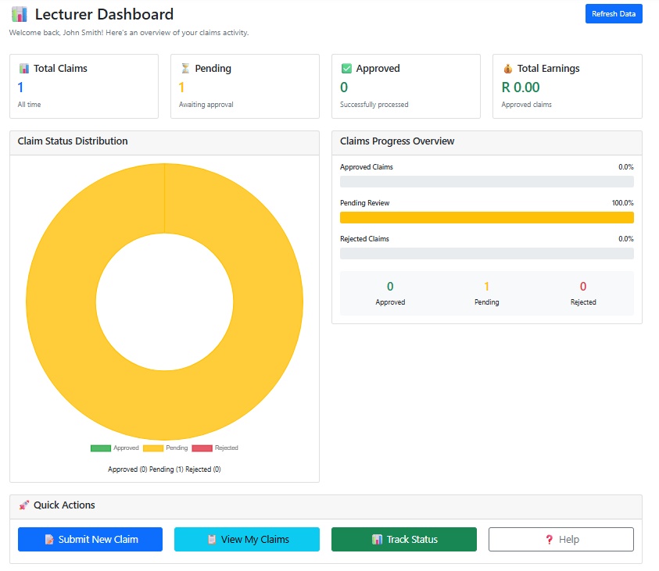
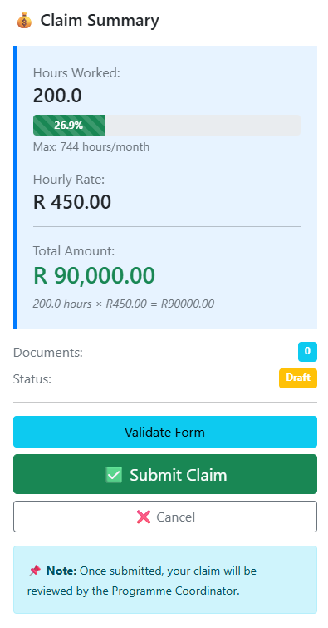
Lecturer Module Features & Interface
My Claims Interface
View all total, pending and approved claims
View claim approved tracking, whose approved it and when
Filter which claim has been approved or still pending
Dashboard Interface
Real-time dashboard with comprehensive statistics display
View complete claim history with detailed status
Resubmit returned claims with revision capabilities
Submit Claims Interface
Submit monthly claims with automated calculations feature
Upload supporting documents in multiple formats
Real-time validation and policy checking system

Slide 8
Automated Verification System Intelligence
0.1-744
Hours Range
R1-9999
Rate Range
0-100
Risk Score
24/7
Auto Check
Policy Validation
Comprehensive policy checks ensure all claims meet institutional guidelines and regulatory requirements automatically.
Hours validation between 0.1 and 744 monthly
Rate verification within R1 to R9,999.99 range
Duplicate detection and document verification system
Risk Assessment
Intelligent risk scoring algorithm categorizes claims for appropriate review levels and processing priorities.
0-29: Low Risk for automatic approval readiness
30-49: Medium Risk requiring careful review process
50+: High Risk needing mandatory manual review
Smart Recommendations
AI-powered system provides intelligent approval suggestions and flags potential anomalies for review.
System suggests optimal approval action paths
Automatic flagging of anomalies and warnings
Contextual recommendations based on historical data

Slide 9
Multi-Level Approval Workflow Process
1.Lecturer Submission
Submit claim with documents and automated calculations validation.
2.Coordinator Review
First-level verification with automated checks and risk assessment.
3.Manager Approval
Final approval decision with payment authorization capability.
4.Payment Processing
Approved claims ready for payment with complete audit trail.

Slide 10
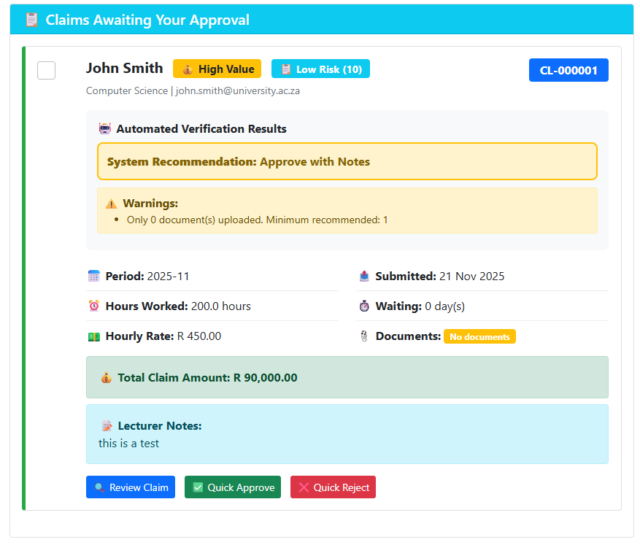
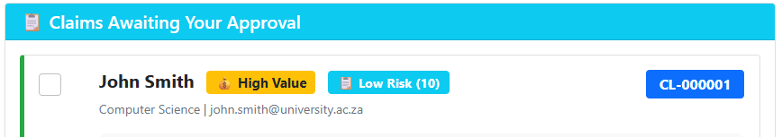
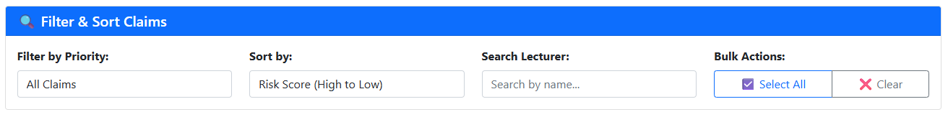
Coordinator & Manager Review Interface
Automated Verification Display
Review interface prominently displays automated verification results with risk scores, policy warnings, and system recommendations to guide approval decisions effectively.
Priority Management Tools
Advanced sorting and filtering capabilities allow coordinators to prioritize urgent, high-risk, and high-value claims with bulk approval actions for efficiency.

Slide 11
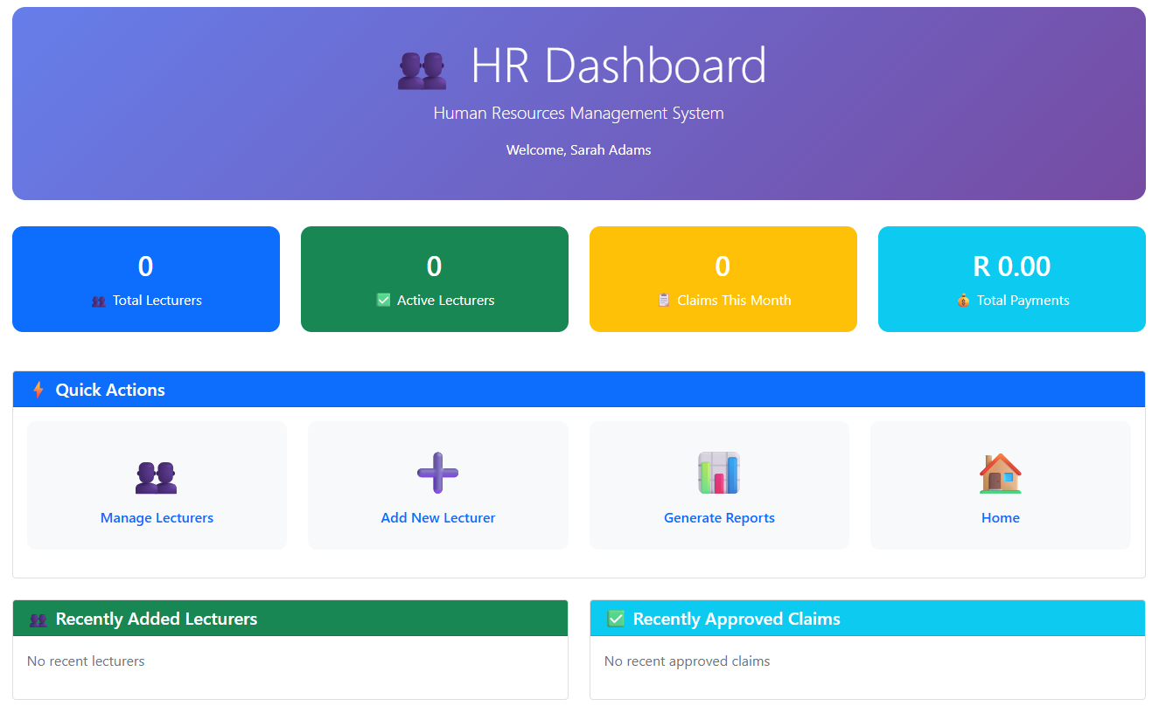
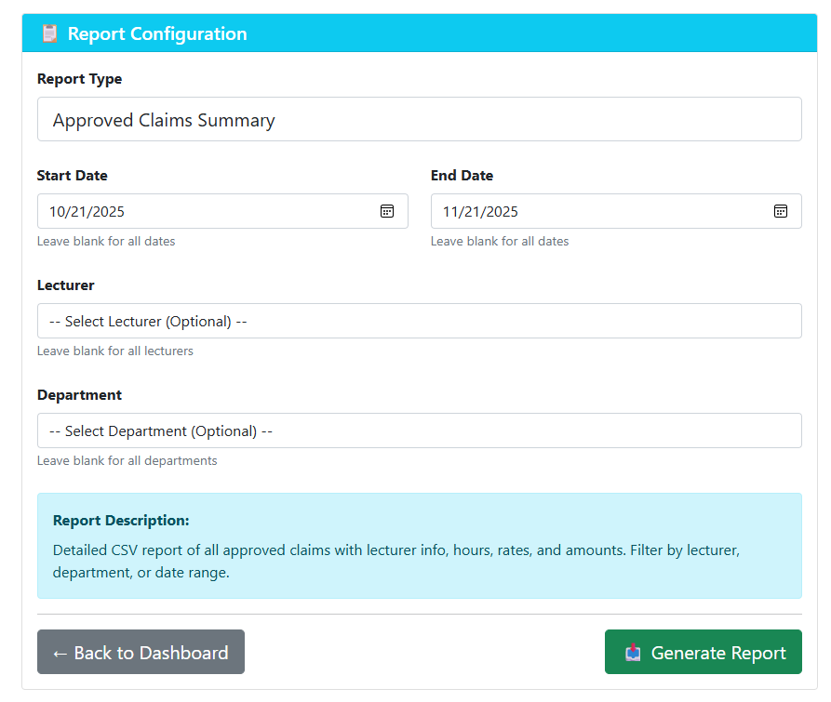
HR Management Module Capabilities
Lecturer Account Management
Create new lecturer accounts with complete profile setup
Update lecturer information and contact details management
Activate or deactivate accounts with security controls
Manage hourly rates and department assignments
Comprehensive Reporting Suite
Approved Claims Summary with detailed CSV exports
Lecturer Payment Reports with earnings breakdown
Monthly Claim Reports and lecturer directory listings
Professional payment invoices for record keeping

Slide 12
Reports & Analytics Dashboard
Advanced Reporting System
The CMCS reporting module provides comprehensive analytics with five distinct report types, enabling detailed financial tracking, audit compliance, and administrative oversight with professional export capabilities.
CSV Export Reports
Export detailed approved claims, lecturer payments, and monthly aggregated data for Excel analysis and external processing.
Professional Invoices
Generate printable payment invoices with institutional branding for formal record keeping and payment processing.
Advanced Filtering
Filter reports by date ranges, specific lecturers, departments, and claim status for targeted analysis and compliance.

Slide 13
Technical Architecture Overview
Tier | Components | Technologies | Responsibility
Presentation | Views, Razor Pages, UI | HTML, CSS, Bootstrap, JavaScript | User interaction and display
Business Logic | Controllers, Services, Validation | ASP.NET Core MVC, C# | Process requests, enforce rules
Data | Models, DbContext, Database | Entity Framework, SQLite | Data storage and retrieval
ASP.NET Core 8.0
Modern MVC framework with C# 12 language features providing robust performance and scalability.
Entity Framework Integration
SQLite database with EF Core ORM ensuring data integrity and efficient query performance optimization.

Slide 14
Database Design & Relationships
Users Table Structure
Centralized user management storing all account types including lecturers, coordinators, managers, and HR personnel with role-based access control and authentication data.
Claims Entity Model
Comprehensive claim tracking with status management, submission dates, approval workflow stages, and automated calculation fields for complete lifecycle management.
Document Management System
Supporting documents storage with metadata tracking, file type validation, size restrictions, and secure retrieval mechanisms for audit compliance and verification.

Slide 15



Security Features Implementation
Access Control Foundation
Role-based access control ensures users only access authorized content with secure session management and authentication protocols.
Input Validation Layer
Comprehensive server-side and client-side validation with anti-forgery tokens providing CSRF protection and data integrity.
Advanced Security Measures
Parameterized queries prevent SQL injection, file upload security with type restrictions, and model validation attributes ensure data safety.

